Slide 1
FaceShifter

Slide 2

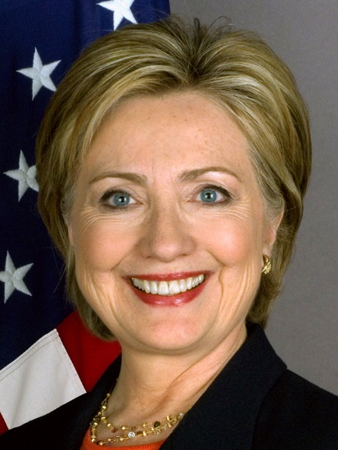

FaceShifter
face swapping
facial reenactment

Slide 3
FaceShifter

Slide 4
History
Face2Face：Real-time Face Capture and Reenactment of RGB Videos（转换面部表情）
Deepfake：Face Swapping（换脸 / 换五官）
HeadOn：Real-time Reenactment of Human Portrait Videos（转换面部表情与躯干运动）
FSGAN：Subject Agnostic Face Swapping and Reenactment （换脸 & 转换面部表情）

Slide 5
Related Works
3D-Based Approaches
2DASL: Joint 3D Face Reconstruction and Dense Face Alignment from A Single Image with 2D-Assisted Self-Supervised Learning
MVF-Net: Multi-View 3D Face Morphable Model Regression
Towards High-Fidelity Nonlinear 3D Face Morphable Model
3DFC: 3D Face Modeling from Diverse Raw Scan Data
GAN-Based Approaches
faceswap-GAN: Adding Adversarial loss and perceptual loss (VGGface) to deepfakes'(reddit user) auto-encoder architecture
GANimation: Anatomically-aware Facial Animation from a Single Image
FSGAN：Subject Agnostic Face Swapping and Reenactment

Slide 6
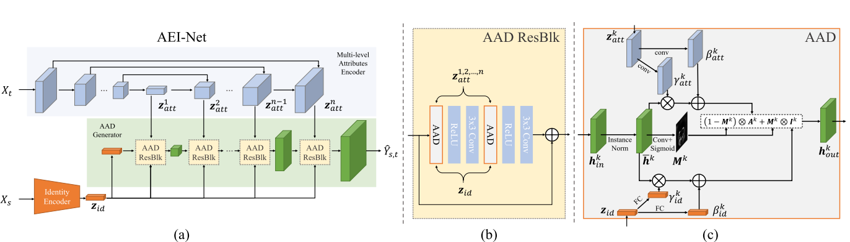
AEI-Net

Slide 7
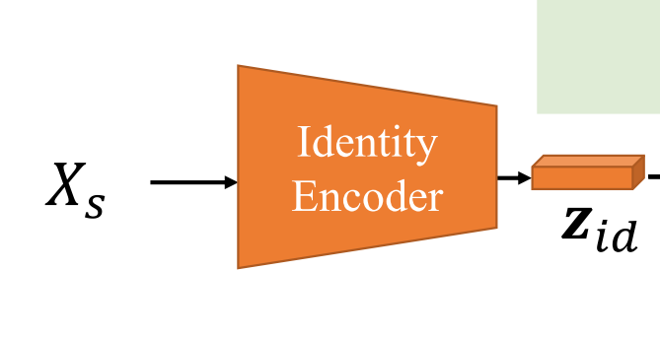
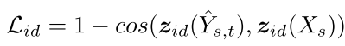
Identity Encoder
Arcface: Additive angular margin loss for deep face recognition.

Slide 8
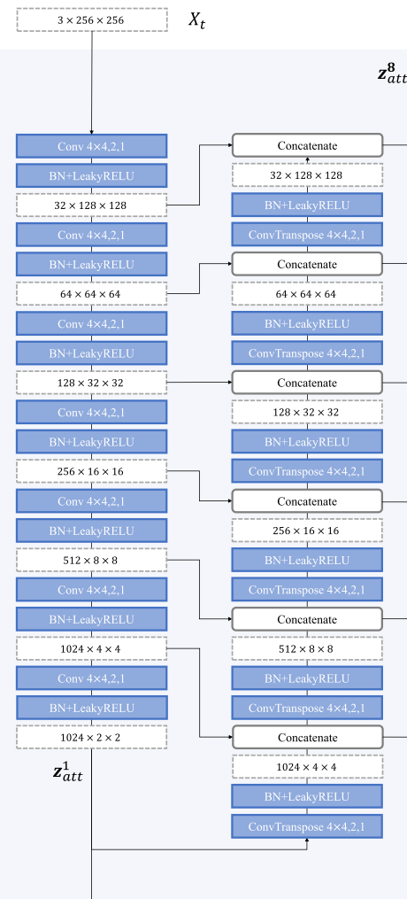
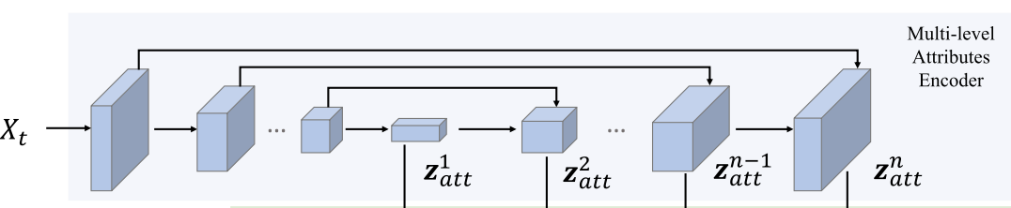
Multi-level Attributes Encoder

Slide 9
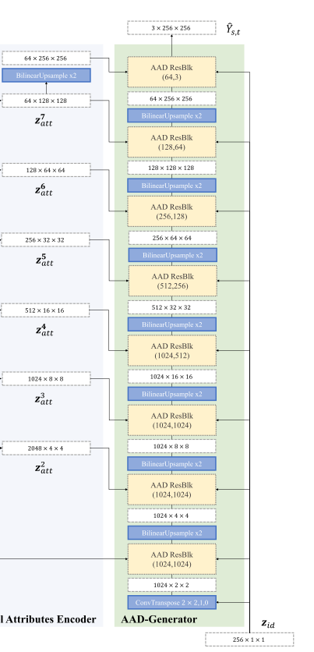
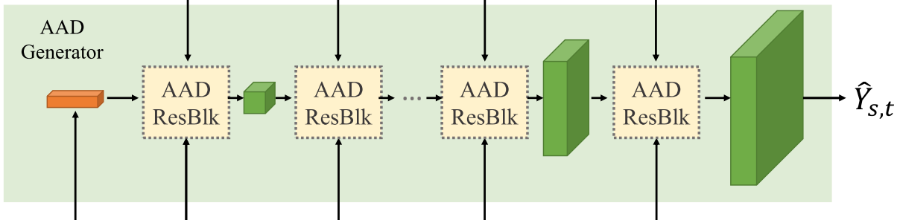
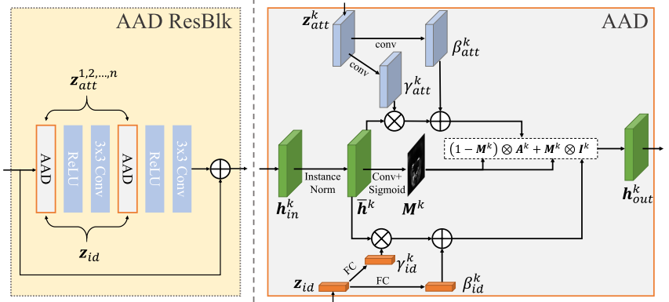
AAD Generator

Slide 10
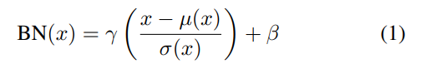
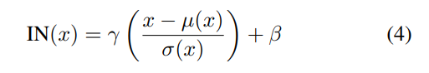
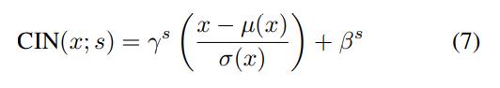
AdaIN
Batch Normalization
Instance Normalization
Conditional Instance Normalization

Slide 11
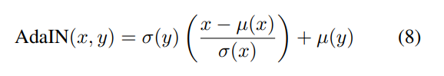
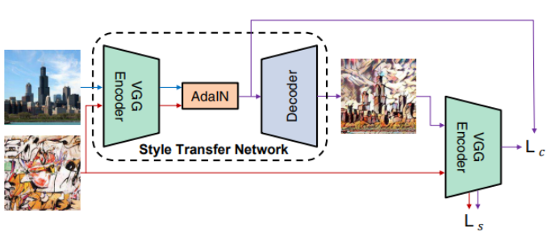
AdaIN
Notes:
AdaIN 接收一张 content input X 和 一张 style input Y，并且简单地对 X 进行 channel wise mean and variance 使其可以匹配 Y。与 BN, IN, CIN 不同，AdaIN 没有可学习的 affine parameters。其根据输入的 style image，自适应的生成 affine parameters：

Slide 12
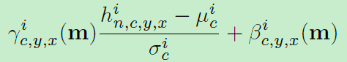
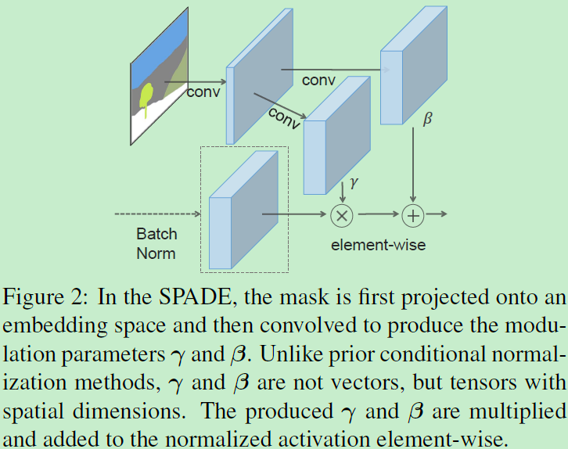
SPADE
Notes:
https://www.cnblogs.com/king-lps/p/12485351.html

Slide 13
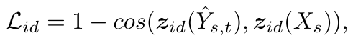
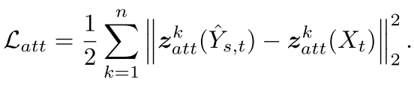
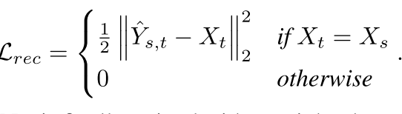

loss

Slide 14
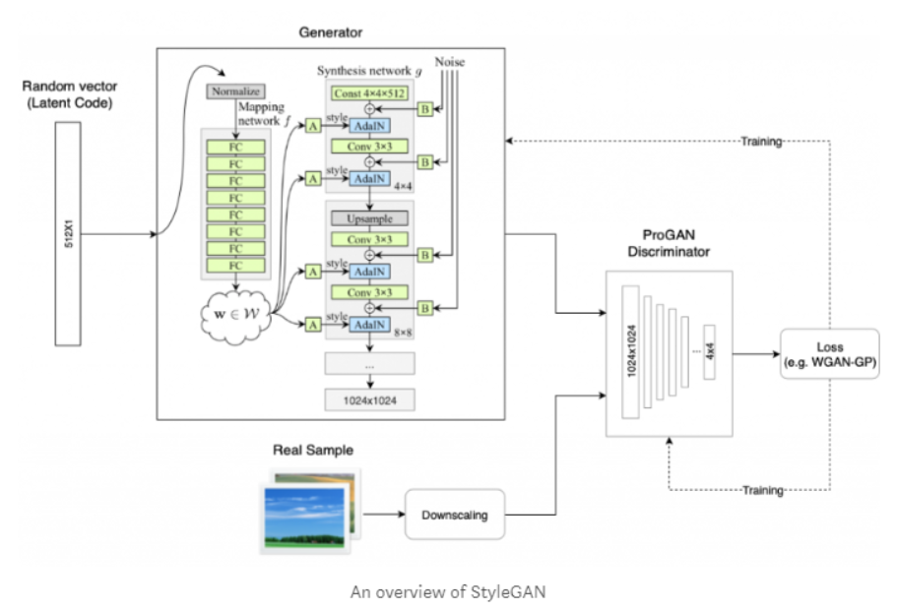
styleGAN loss
Notes:
Discriminator
由于生成的图像分辨率非常高，如果同传统的gan采用一样的discriminator，存在两个难题
这个discriminator网络要么得足够深要么得足够宽，才有可能有足够的perceptive field，足以判断这张高分辨率图像的真伪，将容易引起overfit。
即使不会overfit，由于图像分辨率非常高，这个辨别器只能感知到图像的全局信息，而容易忽略了局部细节信息，即便生成的图像细节有问题，也可能被判别为好图像，这会使生成器生成图像忽略细节
为了解决这个问题，作者引入了多尺度辨别器，即对高分辨率图像构建多尺度金字塔（原文构建了三层金字塔），然后采用3个网络结构一样的辨别器对多尺度图像进行判别，很好地解决了上述两个问题。

Slide 15
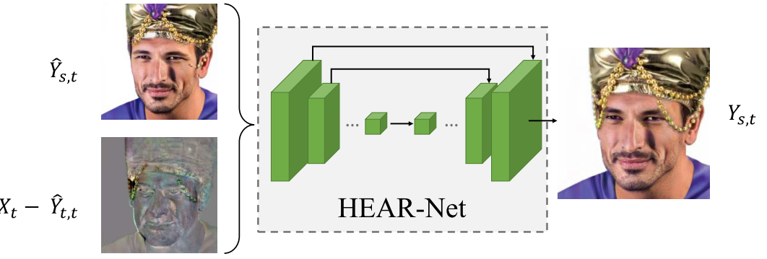
HEAR-Net

Slide 16
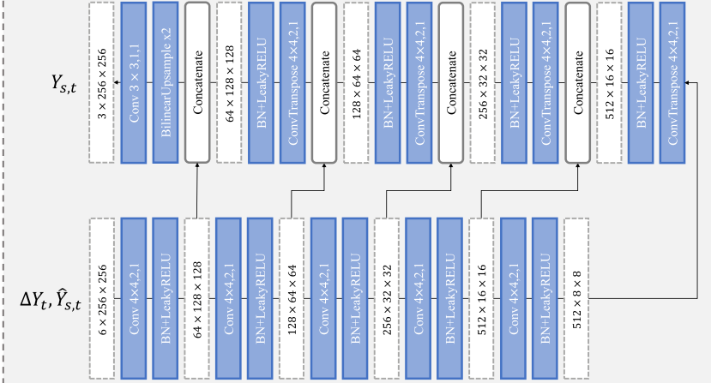
HEAR-Net

Slide 17
Training Strategies
training Xt = Xs is 80% for AEI-Net, 50% for HEAR-Net.
ADAM with β1 = 0, β2 = 0.999, lr = 0.0004
AEI-Net 500K steps, HEAR-Net 50K steps
Self-supervised learning for HEAR-Net

